Slide 1

21CSS101J
Programming for problem solving
HEART DISEASE PREDICTION detector
Using Machine Learning with SMOTE & Gradio in Google Colab
By:
Sneha Maji (RA2411004010126)
Ananya Maurya (RA2411004010180)
Arpita Choudhury (RA2411004010177)

Slide 2
ABSTRACT:
PROBLEM STATEMENT: Cardiovascular diseases are a leading cause of morbidity and mortality worldwide, yet many individuals lack access to personalized health assessments that can help them understand their heart health. Traditional health assessment methods can be complex and difficult for non-medical individuals to interpret, leading to a gap in awareness and proactive health management.
INDICATION OF METHODOLOGY: This project introduces a web-based application that utilizes OpenAI's language model to generate personalized heart health reports based on user-provided patient data. The application collects various health metrics, including age, sex, chest pain type, blood pressure, cholesterol levels, and other relevant factors. The data is processed through the language model, which interprets the information and generates a comprehensive health report.
MAIN FINDINGS: The application successfully generates detailed and user-friendly health reports that include interpretations of the patient's values, risk assessments, and lifestyle and diet suggestions. Users receive insights tailored to their specific health profiles, enabling them to make informed decisions regarding their heart health.
PRINCIPAL CONCLUSION: The personalized heart health report generator demonstrates the potential of leveraging advanced AI technologies to enhance individual understanding of cardiovascular health. By providing accessible and comprehensible health assessments, the application aims to empower users to take proactive steps in managing their heart health and improving their overall well-being..
AB

Slide 3
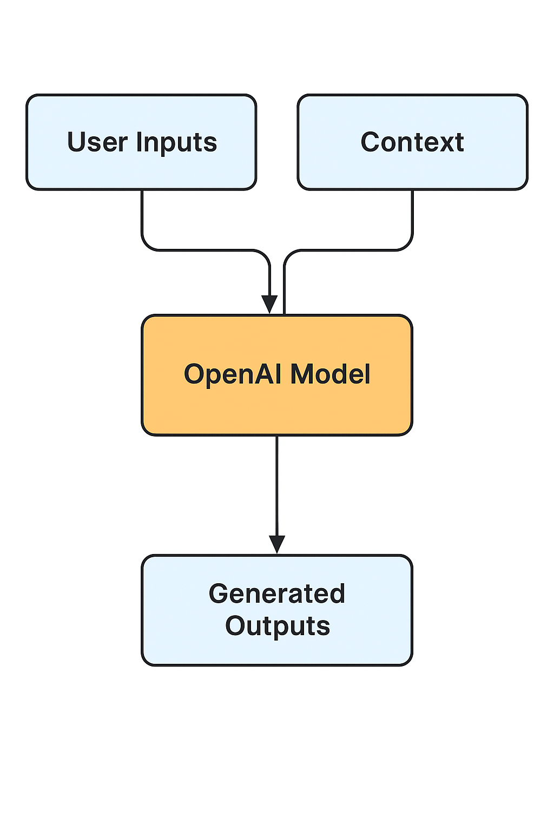
BLOCK DIAGRAM:

Slide 4
Charcterisctics of dataset:
The application requires the following patient data:
Age: Numeric value representing the patient's age.
Sex: Male or Female.
Chest Pain Type (cp): Categorical (Typical, Atypical, Non-anginal, Asymptomatic).
Resting Blood Pressure (trestbps): Numeric value in mm Hg.
Cholesterol (chol): Numeric value in mg/dL.
Fasting Blood Sugar (fbs): Yes or No.
Resting ECG (restecg): Categorical (Normal, ST-T wave abnormality, Left ventricular hypertrophy).
Max Heart Rate Achieved (thalach): Numeric value.
Exercise Induced Angina (exang): Yes or No.
ST Depression (oldpeak): Numeric value.
Slope of ST Segment (slope): Categorical (Upsloping, Flat, Downsloping).
Number of Major Vessels (ca): Numeric value (0-3).
Thalassemia Type (thal): Categorical (Normal, Fixed Defect, Reversible Defect).

Slide 5

Significance OF DATASET:
Comprehensive Health Metrics:
The dataset includes a wide range of health metrics that are known to influence heart disease risk, allowing for a thorough analysis.
Predictive Modeling:
By utilizing these features, the predictive model can identify patterns and relationships that indicate the likelihood of heart disease, enabling early detection and intervention
Data Diversity:
The inclusion of both categorical and continuous variables provides a rich dataset for machine learning algorithms, enhancing the model's ability to generalize and make accurate predictions.
Clinical Relevance:
The features selected are clinically relevant, making the model applicable in real-world healthcare settings where timely and accurate heart disease detection is crucial.

Slide 6
Algorithm:
Step 1: Collect patient data through the web interface.
Step 2: Format the data into a prompt for the OpenAI API.
Step 3: Send the prompt to the OpenAI API and receive a response.
Step 4: Parse the response to extract the health report.
Step 5: Display the report to the user in a user-friendly format.

Slide 7
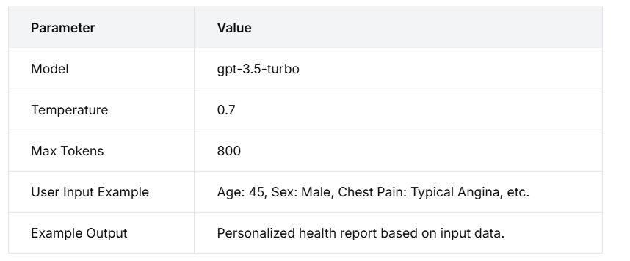
Result:
Introduction: Development of a personalized heart health report generator using OpenAI's GPT-3.5-turbo model. Significant advancement in the accessibility of cardiovascular health assessments. Utilizes advanced AI technology to interpret complex medical data. Provides tailored insights based on user input (age, sex, chest pain type, etc.).Aims to enhance patient understanding of cardiovascular health. Promotes proactive health management.
Evaluation: Successfully generates comprehensive health reports with: Interpretations of patient values. Risk assessments. Lifestyle and diet suggestions. Operates with: Temperature setting of 0.7.Maximum token limit of 800. Literature indicates AI can improve patient engagement and understanding. Bridges the gap between complex medical data and patient comprehension. Potential for better health outcomes and informed decision-making.
Conclusion Acknowledges limitations: Accuracy depends on the quality and completeness of user input. May not capture nuances of individual health conditions—recommendation for users to consult healthcare professionals for comprehensive evaluations. Future iterations could incorporate: Real-time data. Feedback mechanisms to enhance accuracy and reliability.

Slide 8

Future Roadmap
Model explainability using SHAP
Larger dataset integration
Mobile deployment
Clinical trials for validation
Integration with wearable health tech

